Slide 1

CHECK IN CHECK OUT C-IN C-OUT

Slide 2




THE TEAM
IBM Mentor
Ms. Priya Kalra
Edunet Mentor
Mr. Ankur Mishra
Students Name
Mantu Rana
Sumit Singh
Madan H S
Mayank Pathak

Slide 3
WORKLOAD DIVISION
Contribution of each team member in project
Sumit Kumar Singh : Frontend / Backend Development / Database / Deployment
Mantu Kumar Rana : Backend Development / Database
Madan H S : Frontend Development / Resources
Mayank Pathak : Frontend Development / Documentation

Slide 4
THE BACKGROUND
Early Biometric Attendance Systems: Initial biometric systems relied on fingerprints or iris scans but faced challenges such as wear and tear of sensors and data privacy concerns. The need for more secure and non-intrusive methods led to research into face recognition technology.
CCTV Integration for People Counting: In parallel, businesses and public spaces used CCTV systems for basic people counting. Manual review of footage or basic motion detection algorithms were the standard approaches, but these were resource-intensive and lacked real-time insights.
Post-COVID-19 Era: The pandemic accelerated the demand for contactless technologies, leading to widespread adoption of face recognition for attendance and automated people counting in offices, schools, and public spaces to ensure social distancing and safety compliance.

Slide 5
PROBLEM STATEMENT
The problem is to develop an automated, contactless face attendance system with real-time people counting to replace manual or basic biometric methods, improving accuracy, eliminating fraud, and enabling efficient monitoring of attendance and occupancy in environments like schools, offices, and public spaces.
AI in Surveillance and Attendance Systems.

Slide 6
PROPOSED SOLUTION
The proposed solution is to create an AI-powered face recognition system integrated with real-time people counting. This system will automate attendance tracking and occupancy monitoring, using computer vision techniques for accurate, contactless operation. It will be deployed through an interactive platform like Streamlit, ensuring ease of use and real-time data processing for various environments such as schools, offices, and university & hospitals.

Slide 7
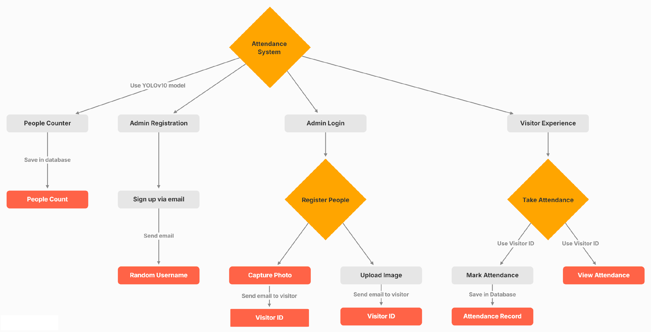
SOLUTION DESIGN

Slide 8
TECHNOLOGY STACK & REQUIREMENTS
OpenCV & YOLO: For real-time face recognition and accurate people counting due to their speed and reliability.
Streamlit: Chosen for fast deployment and creating an interactive UI with minimal effort.
Hardware: Minimum 8GB RAM, GPU , camera for video feed.
Software: Python, OpenCV, Tensor Flow, Pytorch, Yolo,Streamlit, and necessary libraries.
.

Slide 9

INNOVATIVE IDEA
An innovative idea is to integrate real-time anomaly detection alongside face recognition and people counting. This feature would alert administrators to unusual activities, such as overcrowding or unauthorized access, enhancing security and crowd management. Additionally, implementing a self-learning AI model that improves accuracy over time based on environmental changes (lighting, angles) would make the solution more adaptable and precise compared to other static systems.
Another innovative idea is that on admins can login & register according to there job roles in different organizations , School & University , Hospital , Office.

Slide 10
RESULTS / OUTCOMES / ANALYSIS
Contactless & Fraud-Free: Eliminates buddy punching and ensures hygiene.
Real-Time Monitoring: Provides instant attendance updates and people counting.
Scalability: Easily deployable across large campuses, offices, Hospitals, Schools & University.
Efficiency: Reduces administrative burden, saving time and effort.

Slide 11

LIMITATIONS
Lighting Sensitivity: The system's accuracy can be affected in poor or inconsistent lighting conditions, leading to missed face detections.
Occlusion Issues: Faces partially obscured (e.g., by masks or objects) may not be recognized accurately, affecting attendance recording.
Processing Power: Real-time face recognition and people counting require significant computational resources, especially in high-traffic areas, which may cause latency on lower-end hardware.
Edge Case Handling: The system may struggle with non-human objects being mistakenly counted or classified as people in crowded environments.

Slide 12

FUTURE ENHANCEMENTS/SCOPE
Voice-Activated Attendance: Enable voice recognition for hands-free check-ins, especially useful in settings where touch is minimized (e.g., hospitals).
Mask Detection & Adaptation: Include the ability to recognize faces even when partially covered improving accuracy in post-pandemic settings.
Multi-Camera Integration: Allow for the use of multiple cameras in larger spaces to cover blind spots and improve people counting in complex environments.
Mobile App Development : Provide employees and staff the ability to mark attendance using their mobile phones once they enter the premises or reach a certain geolocation, offering flexibility and enhancing user convenience.

Slide 13
GITHUB LINK HTTPS://GITHUB.COM/RAJPUTROCKSTAR/CINCOUT.GIT

Slide 14
THANK YOU

